Slide 1
Pre-Historic Natives Passage, Chart and Questions Extra Credit
Use the passage provided to fill in the chart and answer the questions provided.
Student Name: x
Class Period: x
Date Completed: x
Assignment for Extra Credit points to apply towards: x

Slide 2
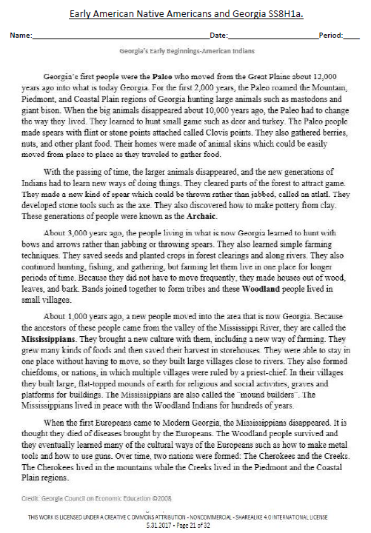

Slide 3
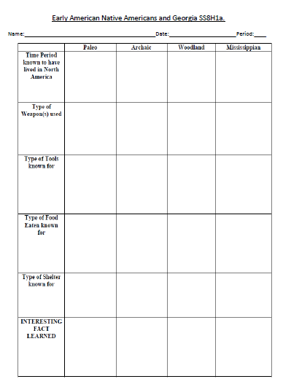
Type Your Answer Here
Type Your Answer Here
Type Your Answer Here
Type Your Answer Here
Type Your Answer Here
Type Your Answer Here
Type Your Answer Here
Type Your Answer Here
Type Your Answer Here
Type Your Answer Here
Type Your Answer Here
Type Your Answer Here
Type Your Answer Here
Type Your Answer Here
Type Your Answer Here
Type Your Answer Here
Type Your Answer Here
Type Your Answer Here
Type Your Answer Here
Type Your Answer Here
Type Your Answer Here
Type Your Answer Here
Type Your Answer Here
Type Your Answer Here

Slide 4
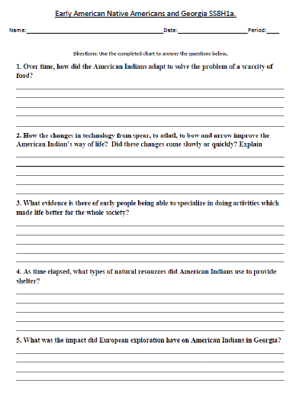
Type Your Answer Here
Type Your Answer Here
Type Your Answer Here
Type Your Answer Here
Type Your Answer Here

