Slide 1
Georgia Cities Word Search and Map
Use the Draw Feature to mark the terms in the Word Search. Once you have found the terms, mark the city’s location on the map on slide 3.
Student Name: x
Class Period: x
Date Completed: x
Assignment for Extra Credit points to apply towards: x

Slide 3
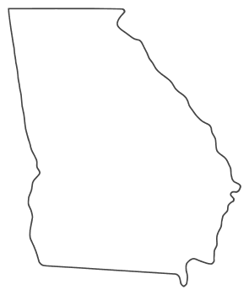
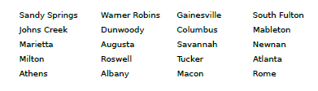
Map the cities by using the draw feature, or by adding shapes to the map.

