Slide 1
James Oglethorpe Info
Use the reading provided to match the terms and answer the questions on slide 4 and 5.
Student Name: x
Class Period: x
Date Completed: x
Assignment for Extra Credit points to apply towards: x

Slide 2
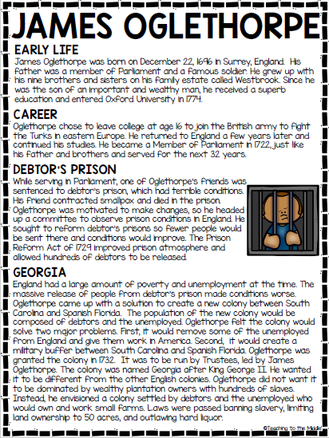

Slide 3
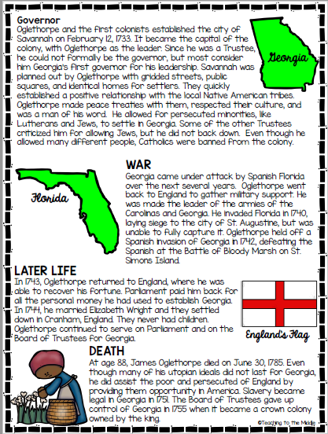

Slide 4
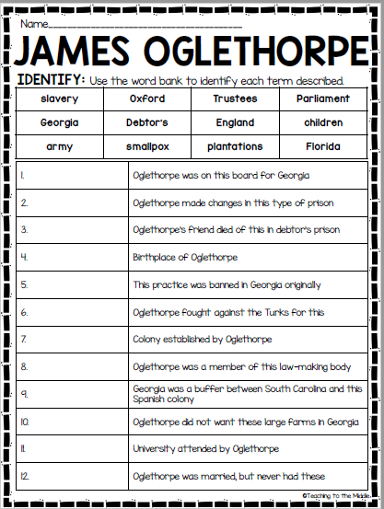
Identify: Move the boxes blow next to their definition
slavery
Oxford
Trustees
Parliament
Georgia
Debtor’s
England
children
army
smallpox
plantations
Florida

Slide 5
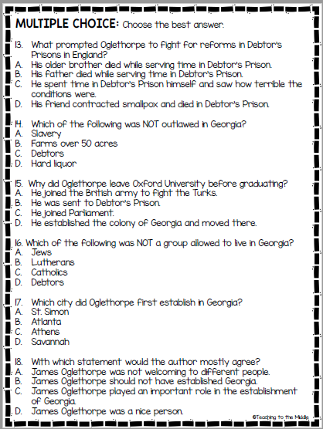
Multiple Choice: Use the draw feature (highlight option) to mark your answer.

