Slide 1
H2b- Founders of Georgia Acrostic Poems
Come up with words or phrases that describe the person, what they did, how they relate to Georgia, ect. That begin with the letters of their name.
To type your words or phrases, please insert a text box by going to the “Insert” tab, and select “Text” or “Insert Text Box”
Student Name: x
Class Period: x
Date Completed: x
Assignment for Extra Credit points to apply towards: x

Slide 2
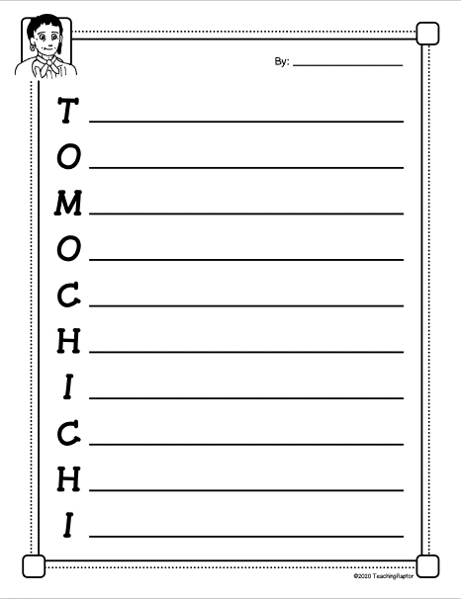
X

Slide 3
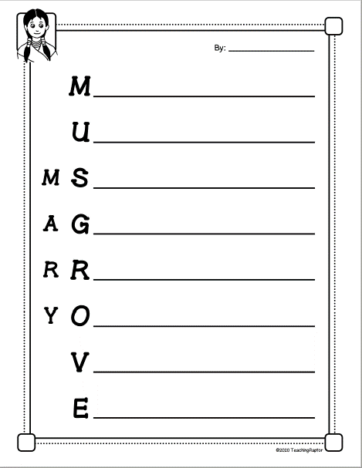
X

Slide 4
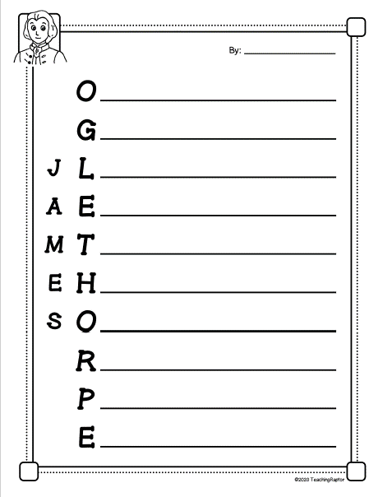
X

